Slide 1

Lecture3
Bisection Method

Slide 2
Numerical methods for finding the roots of a function
The roots of a function f (x) are defined as the values for which the value of the function becomes equal to zero. So, finding the roots of f (x) means solving the equation
f (x) = 0.

Slide 3
Definition: The equation f (x) = 0 is called an algebraic, if it is purely a polynomial in x;
it is a transcendental if f (x) contains trigonometric, exponential or logarithmic functions

Slide 4
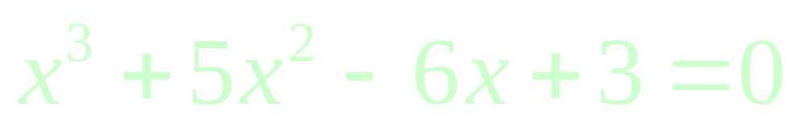

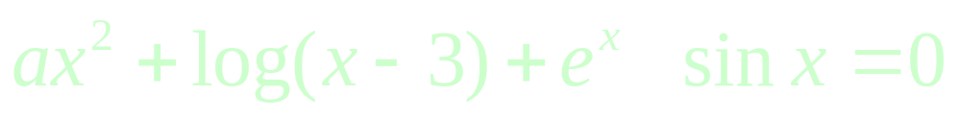
For example
is an algebraic equation,
Whereas
and
are transcendental equations.

Slide 5
To find the solution of an equation f (x) = 0, we find those values of x for which
f (x) = 0
is satisfied.
Such values of x are called the roots of
f (x) = 0.
Thus a is a root of an equation f (x) = 0, if and only if, f (a) = 0.

Slide 6
Properties of an algebraic equation
Every algebraic equation of
n-th degree, where n is a positive integer, has n and only n roots.

Slide 7
Numerical methods for solving either a transcendental equation or an algebraic equation are classified into two groups:
Direct methods, which require no knowledge of the initial approximation of a root of the equation f (x) = 0.
Iterative methods, require first approximation to initiate iteration.

Slide 8
Analytical method
This method is based on ‘intermediate value property’.

Slide 9
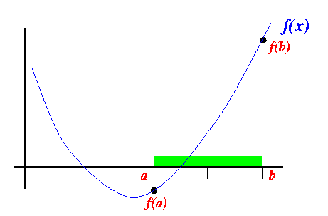
Introduction

Slide 10
Hence, in analytical method, we must always start with an initial interval (a, b), so that f (a) and f (b) have opposite signs.

Slide 11
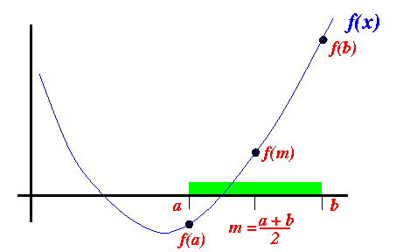
Introduction

Slide 12
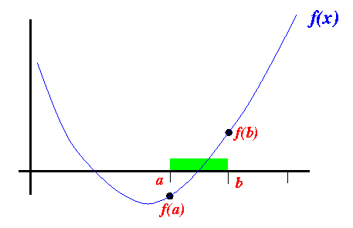
Introduction

Slide 13
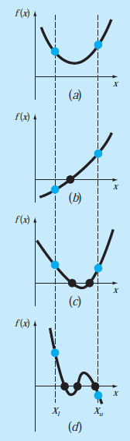
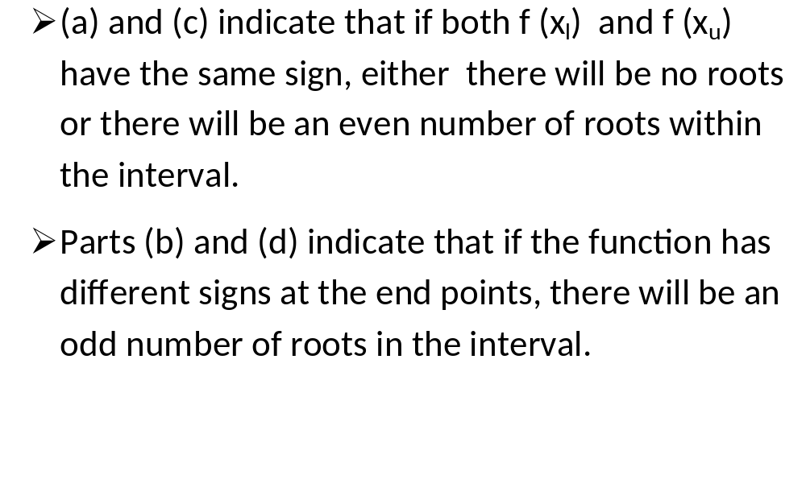
THE BISECTION METHOD
Nasir Uddin Spring 2016

Slide 14
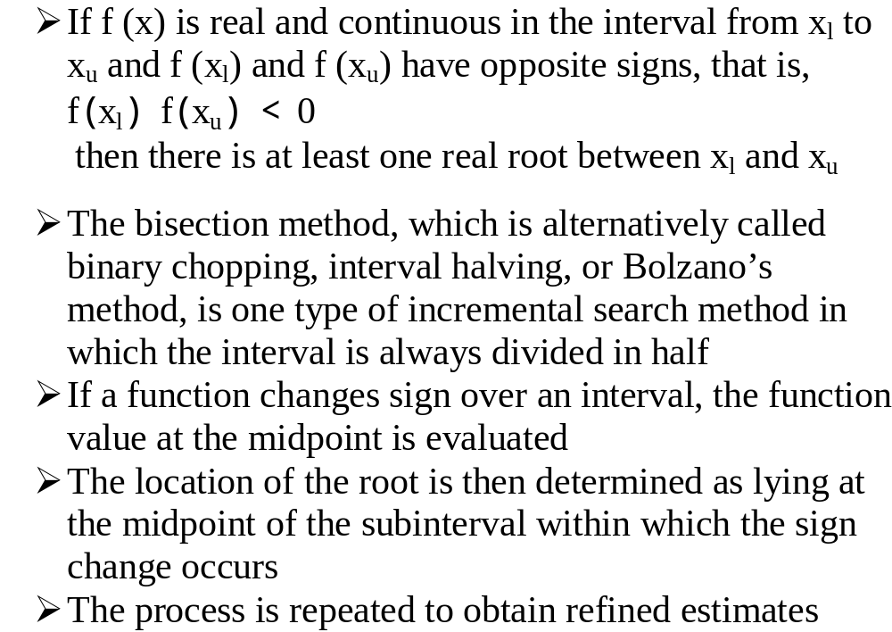
THE BISECTION METHOD

Slide 15
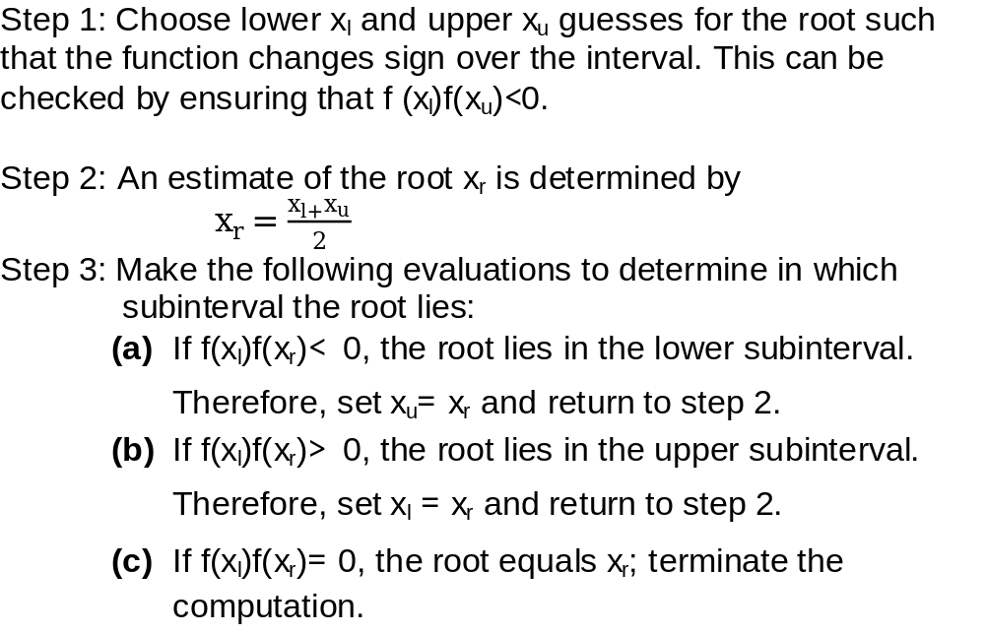
Algorithm for Bisection Method

Slide 16
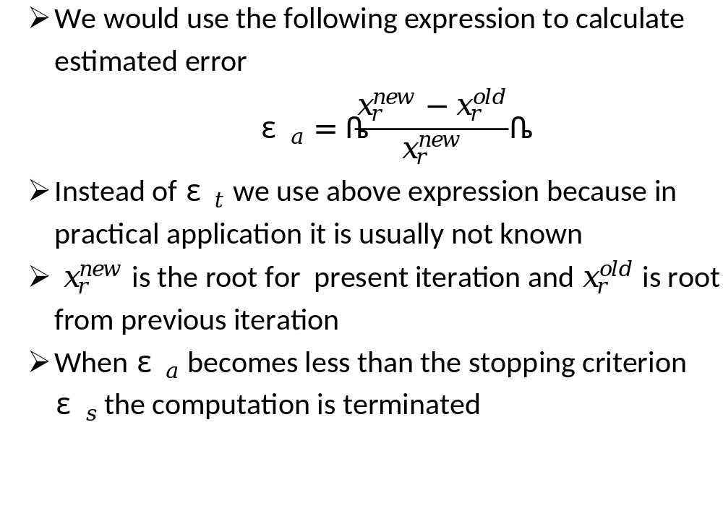
Termination Criteria and Error Estimates

Slide 17
Example 1
Consider finding the root of f(x) = x² - 3. Let
ε_{abs} = 0.01 and start with the interval [1, 2].

Slide 18
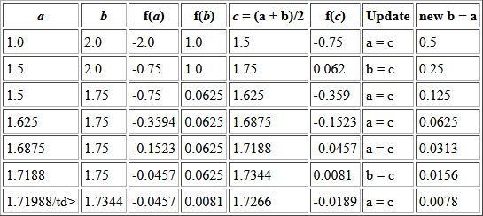
Example 1

Slide 19
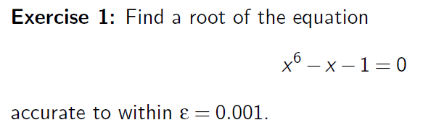
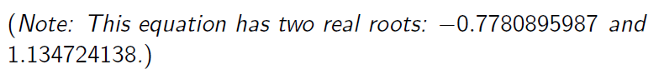
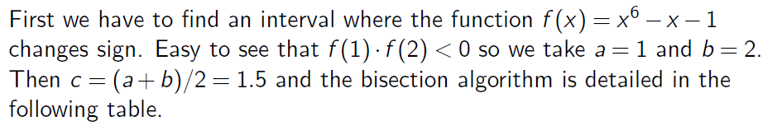
Example 2

Slide 20
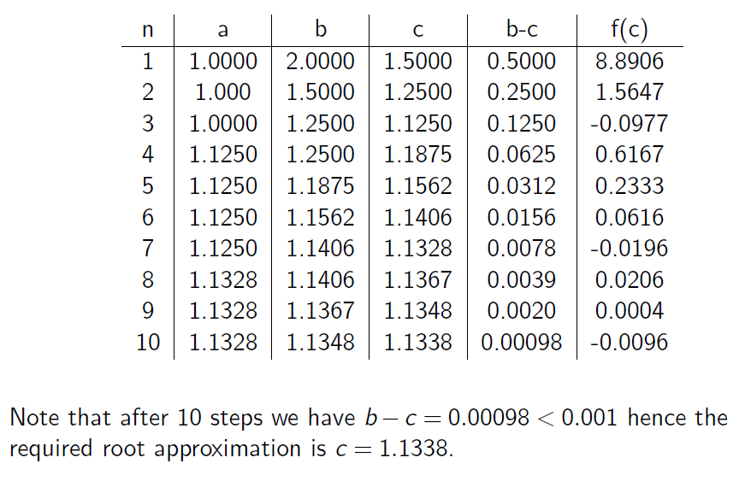
Example 2

Slide 21
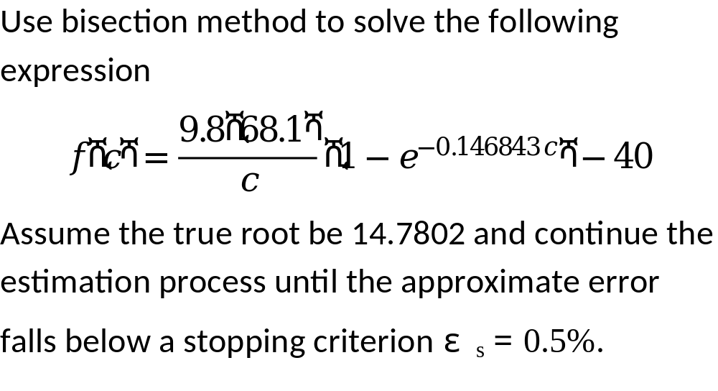
Example 3

Slide 22
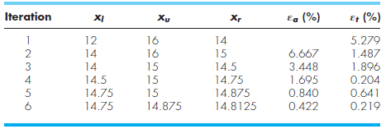
Example 3
Starting with the initial guess used in previous problem we get the following table

Slide 23
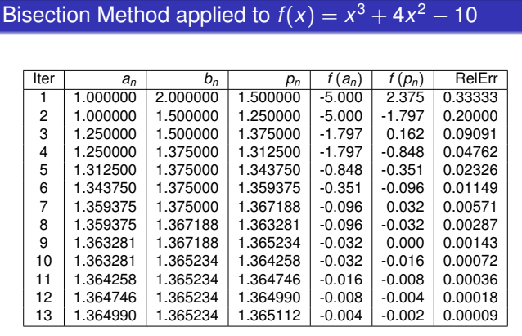

Slide 24
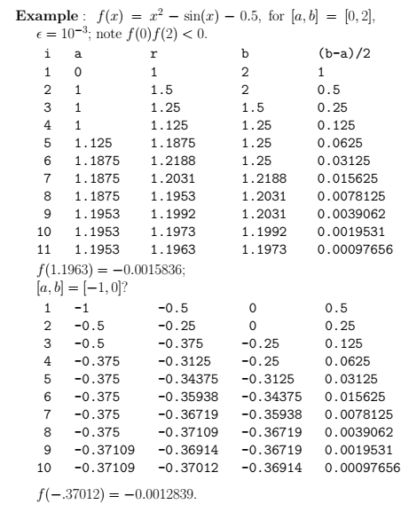

Slide 25
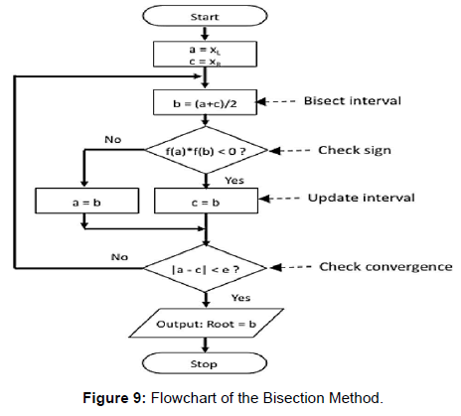
Flow Chart:

Slide 26
Algorithm:
Start
1. Decide initial values for x1 and x2 and stopping criterion, E.
2. Compute f1 = f(x1) and f2 = f(x2).
If f1 * f2>0, x1 and x2 do not bracket any root and go to step 7;
Otherwise continue.
Compute x0 = (x1+x2)/2 and compute f0 = f(x0)
If f1*f0 < 0 then
set x2 = x0
else
set x1 = x0
set f1 = f0
If absolute value of (x2 – x1)/x2 is less than error E, then
root = (x1 + x2)/2
write the value of root
go to step 7
else
go to step 4
7. Stop.

Slide 27
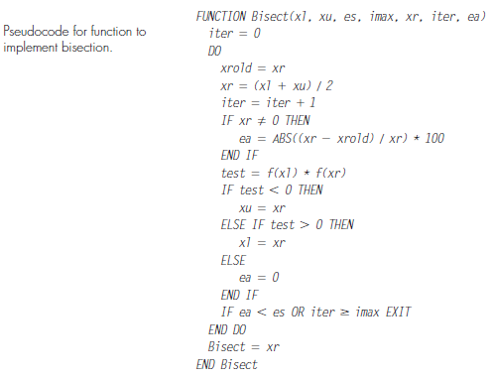

Slide 28
Advantages and Disadvantages
The method is guaranteed to converge
The error bound decreases by half with each iteration
The bisection method converges very slowly
The bisection method cannot detect multiple roots

Slide 29
Assignment # 01
Exercise 1: Consider the nonlinear equation e^x −x −2 = 0.
Show there is a root a in the interval (1,2).
Estimate how many iterations will be needed in order to approximate
this root with an accuracy of e = 0.001 using the bisection method.
c) Then approximate a with an accuracy of e = 0.001 using the
bisection method.
Exercise 2: Find a root of f (x) = x^3 +2x−3x −1 (e = 0.001).
Exercise 3: f (x) = x^10 -1

